Slide 1

Transmission Based Precautions (TBPs) guidance has changed
Antimicrobial Resistance and Healthcare Associated Infection (ARHAI) Scotland
Notes:
ARHAI Scotland develop and maintain the National Infection Prevention and Control Manual (NIPCM). There have been some key updates to Transmission Based Precautions (TBPs) guidance. It’s important that you know what these are to help keep you, patients, colleagues and visitors safe.

Slide 2
What are TBPs?
What has changed?
Why has it changed?
What does this mean for IPC practice?
Who does it apply to?
When did the change happen?
Where can more information be found?
Contents
Notes:
These slides will take you through all the key updates and changes. It is important that you read the guidance in full and links to more information will be provided at the end of these slides.

Slide 3
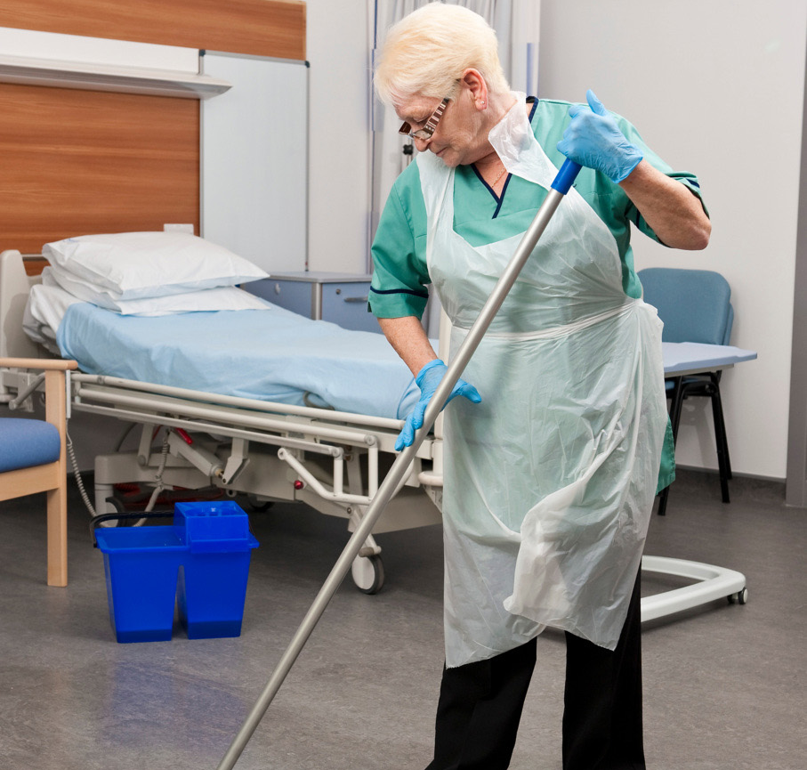
What are Transmission Based Precautions (TBPs)?
Precautions used in addition to Standard Infection Control Precautions (SICPs) when caring for individuals with known or suspected infection
All TBPs are important
  Patient placement
  Safe management of the environment
  Safe management of equipment
  Personal Protective Equipment (PPE)
  Care of the deceased
Notes:
TBPs are the controls applied in addition to Standard Infection Control Precautions (SICPs) when caring for someone with a known or suspected infection or colonisation.
They play a crucial part in preventing the onward transmission of infection to Healthcare workers (HCWs), patients and visitors.
TBPs guidance is fully outlined in the National Infection Prevention and Control Manual (NIPCM) produced by ARHAI Scotland and although a lot of the content within these slides focuses on PPE, all components of TBPs are important
TBPs have been applied in health and care settings for decades and it is important you are aware of some key changes.

Slide 4
What has changed?
Droplet Transmission
Withdrawn
Airborne Transmission
Aerosol Generating Procedures (AGPs)
New descriptors: Contact and Air Transmission
Introduced
Respiratory Categories (R1, R2, R3)
Notes:
The way we describe transmission has changed;
We no longer refer to droplet, airborne and contact
Instead we refer to air transmission and contact transmission
Aerosol Generating Procedures (AGPs) have been withdrawn.
Respiratory categories have been introduced (R1, R2 and R3) and respiratory pathogens allocated to the appropriate category according to the transmission risk that they pose

Slide 5
Accessibility guidance 2
Why has it changed?
Old guidance
Transmission related to particle size & distance only
Large droplets at close range and small aerosols at long range
Didn’t take account other factors which impact transmission
New updated guidance
Takes account of multiple factors which impact transmission
Ensures the National Infection Prevention & Control Manual (NIPCM) remains evidence based
Better prepares us for next pandemic
Notes:
Pre-pandemic, and currently in many IPC guidelines globally, respiratory transmission is described as occurring by either droplet or airborne transmission.
This aligns to an outdated framework based on particle size cut offs whereby respiratory particles larger than 5 microns were described as large droplets that were only encountered at close range, and particles under 5 microns in diameter were described as aerosols and were encountered at longer range. The descriptors took into consideration what was thought to be the predominant mode of transmission based on particle size.
Whilst this approach provided a simple and straightforward IPC framework it led to fierce challenge and debate during the COVID19 pandemic with calls to revise guidance.
A review of the evidence undertaken by ARHAI Scotland has demonstrated that these descriptors are no longer fit for purpose and do not reflect what is happening in reality.
This is also supported by findings from the COVID 19 Public inquiry
Updated guidance no longer primarily focuses on particle sizes but also takes account of many other factors which affect exposure and subsequently transmission of infectious agents including, symptoms, environment, vulnerability of HCWs and severity of outcome associated with the pathogen
This will ensure that we are better prepared for the next pandemic by enabling a risk based approach.
Internationally, it is recognised that change is needed. In April 2024, the WHO published a global technical consultation report on proposed terminology for pathogens that transmit through the air. Similarly, the US centres for disease control published a draft guideline to Prevent Transmission of pathogens in healthcare settings. The findings of WHO and USCDC are closely aligned to that of the new updated guidance in Scotland.
WHO. Apr 2024. Global technical consultation report on proposed terminology for pathogens that transmit through the air https://www.who.int/publications/m/item/global-technical-consultation-report-on-proposed-terminology-for-pathogens-that-transmit-through-the-air
CDC. Nov 2023. DRAFT 2024 Guideline to Prevent Transmission of Pathogens in Healthcare Settings. Available online at https://stacks.cdc.gov/view/cdc/134943
Scotland is the first country globally to launch national guidance aligned to updated transmission descriptors.

Slide 6

What does it mean for IPC Practice?
General points (Fluid Resistant Surgical Mask or Respiratory Protective Equipment):
  Selection based on Respiratory (R) Category – R1, R2 & R3
  Must be donned on entry to room
  Sessional use in cohorts
Notes:
There are some general changes to the application of fluid resistant surgical masks (FRSM) and respiratory protective equipment (RPE).
Selection of mask type will now be undertaken using an algorithm (Appendix 15) which uses new respiratory categories as a foundation for risk assessment. The R category for each respiratory pathogen can be found in Appendix 11 of the NIPCM.
Masks should be donned before entering the room, and doffed after exiting the room of the individual being cared for. This helps protect against any long range transmission risk. This does not apply to FRSMs worn as part of SICPs for exposure to anticipated splash or spray of body fluids – in these cases FRSMs should be removed when exposure risk ceases.
Masks may now also be worn sessionally if caring for individuals within a respiratory cohort. No need to change between patients in the cohort unless contaminated or damaged.

Slide 7
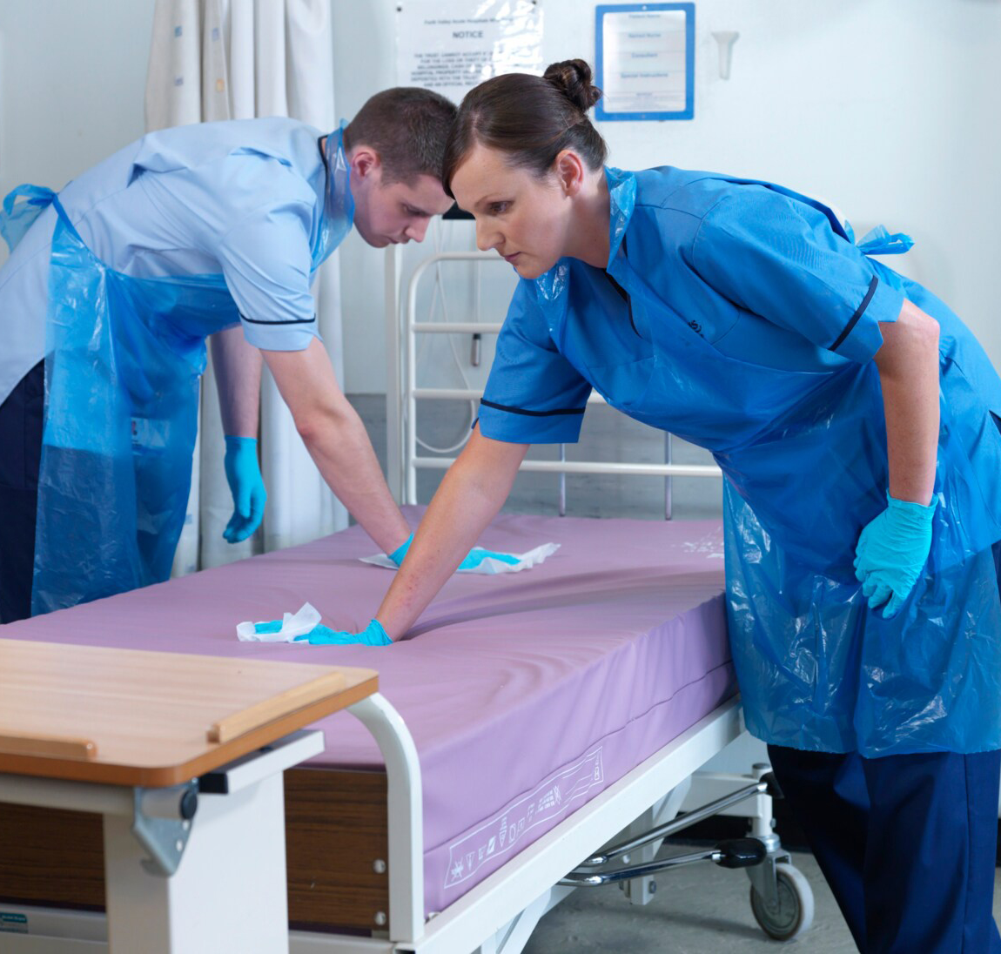
What does it mean for IPC practice?
Fluid Resistant Surgical Masks (FRSM)
  For R1 pathogens
  Worn when pathogen unknown
  Worn when providing care to immunocompromised individuals
  Worn by immunocompromised individuals when leaving protective isolation room
  Extended use by HCWs, Patients and Visitors during epidemic/high rate of local transmission
Notes:
FRSMs should be worn for care of individuals with known or suspected R1 pathogen: table on slide 9 describes in more detail.
FRSM should also be worn on initial presentation if respiratory pathogen unknown unless there are pre assessment indicators which suggest a suspected R2 or R3 pathogen
FRSM should be worn when caring for individuals who are immunocompromised and who require protective isolation. The individual within protective isolation should also wear FRSM if asked to leave their room.
During epidemics or periods of high rate of local transmission extended use of FRSMs by HCWs, visitors and patients may be advised.

Slide 8
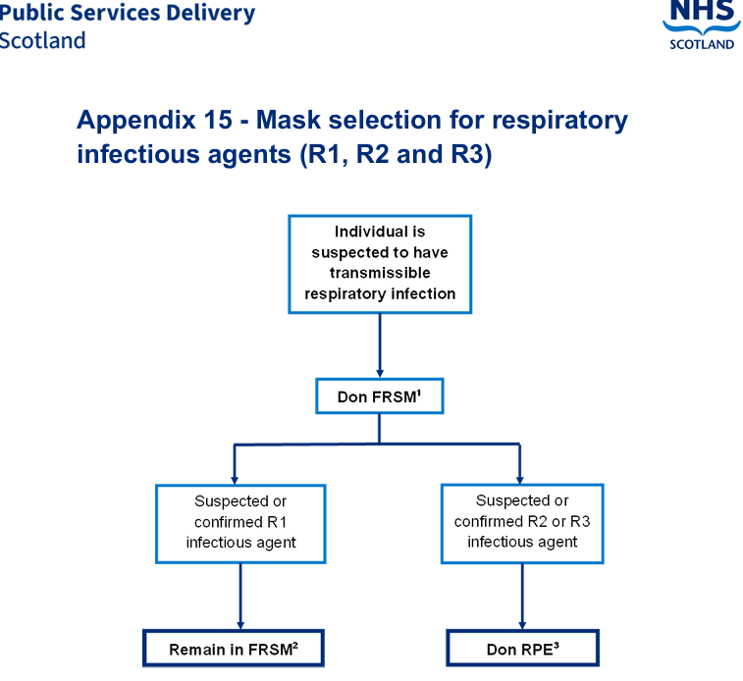
Accessibility guidance 2
What does it mean for IPC practice?
Respiratory Protective Equipment (RPE)
  Worn for R2 and R3 pathogens
  Worn for R1 pathogens
    If advised to do so by personal medical practitioner due to risk of severe outcome
    Personal choice (informed by awareness of risk)
Notes:
RPE should be worn if providing care to an individual with a suspected or confirmed R2 or R3 pathogen.
RPE may also be worn for R1 pathogens if advised by healthcare workers (HCWs) own medical practitioner or as a personal choice.
FFP3 respirators are the most common type of RPE used in healthcare. HCWs MUST be Fit tested prior to donning FFP3 respirators and perform a fit check each time it is donned. Powered respirators may be used as an alternative if a successful FFP3 fit test cannot be achieved.
A mask algorithm (Appendix 15) has been developed to help HCWs decide mask selection.

Slide 9
Accessibility guidance 2
What does it mean for IPC practice?
Category (example pathogens) | Placement Requirements | Mask Type
R1 (Bordetella pertussis, RSV, SARS-CoV-2, Endemic Influenza) | Single en suite room | FRSM*
R2 (Varicella zoster, Pulmonary Tuberculosis, Measles virus, some HCIDs) | NPIR or PPVL or Single en suite room | RPE
R3 (some HCIDs, Novel respiratory virus) | NPIR or PPVL in an IDU | RPE
*Option to wear RPE for R1 pathogens;
  If advised to do so by personal medical practitioner due to risk of severe outcome
  Personal choice (informed by awareness of risk)
Notes:
The table on this slide lays out some of the pathogens within each respiratory category.
Appendix 11 in the NIPCM contains the R category for each respiratory pathogen.
The table outlines the corresponding patient placement requirements and mask requirements according to the R category.
It should be noted that TBP guidance does not replace the High Consequence Infectious Disease (HCID) guidance laid out in the HCID addendum of the NIPCM. If the pathogen is considered an HCID, the HCID addendum must be followed.

Slide 10
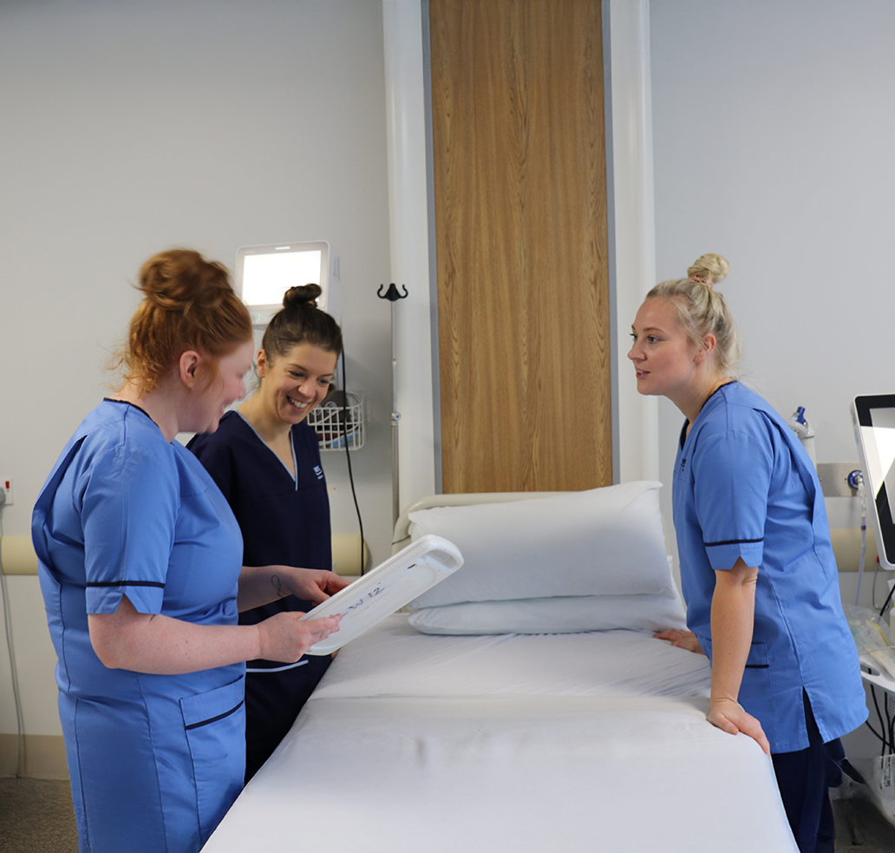
Who does it apply to?
  Any staff member who does or may provide care to an individual with suspected or confirmed infection
  The NIPCM is considered best practice across all health and care settings
  IPC is not setting specific; IPC applies across all settings
Notes:
The new guidance applies across all health and care settings

Slide 11
When did the change happen?
  New guidance was launched on 3rd August 2026
  Scottish Government Director’s Letter (DL)
  6 month bedding in period (commenced August 2026)
  Turas Modules
Notes:
The new guidance was launched in August 2026
Supported by a Scottish Government Directors Letter (DL)
The Care Inspectorate and Healthcare Improvement Scotland (HIS) have confirmed their support for a six-month bedding-in period. This will apply to NHS Boards and care homes for adults and older people, recognising the time required to fully implement the changes. Inspections undertaken during this period will take account of these implementation arrangements.
A dedicated TBP module has been launched on TURAS learn and updates made to the patient placement module to reflect risk assessment in the context of Infection Prevention and Control.

Slide 12
Accessibility guidance 2
Where can more information be found?
  National Infection Prevention and Control Manual (NIPCM)
  Mask Algorithm (app 15)
  What’s Changed Guide
  Frequently Asked Questions (FAQs)
  Literature Review
  Your local Infection Prevention and Control Team (IPCT)
Notes:
The greatest change is across chapter 2 (TBPs) of the NIPCM.
Within chapter 2 you will find links to a What’s changed Guide and FAQs
The literature reviews and considered judgement forms will have also been published in the NIPCM detailing the evidence and discussion at the working group which informed the updated guidance.
You can also contact your local IPCT to find out more

Slide 13
Thank you

